Slide 1
COMMA Project
~ Image Viewer ~

Slide 2
Introduce – Team
COMMA
Member
- 이산아 (조장)
- 김신유
- 배진오
Rule
- http://space.baealex.xyz/comma

Slide 3
Introduce – Project
Goal
- 사용 가능한 프로그램 제작
무엇이 불편한가?
첫번째 프로그램
- Image Viewer

Slide 4
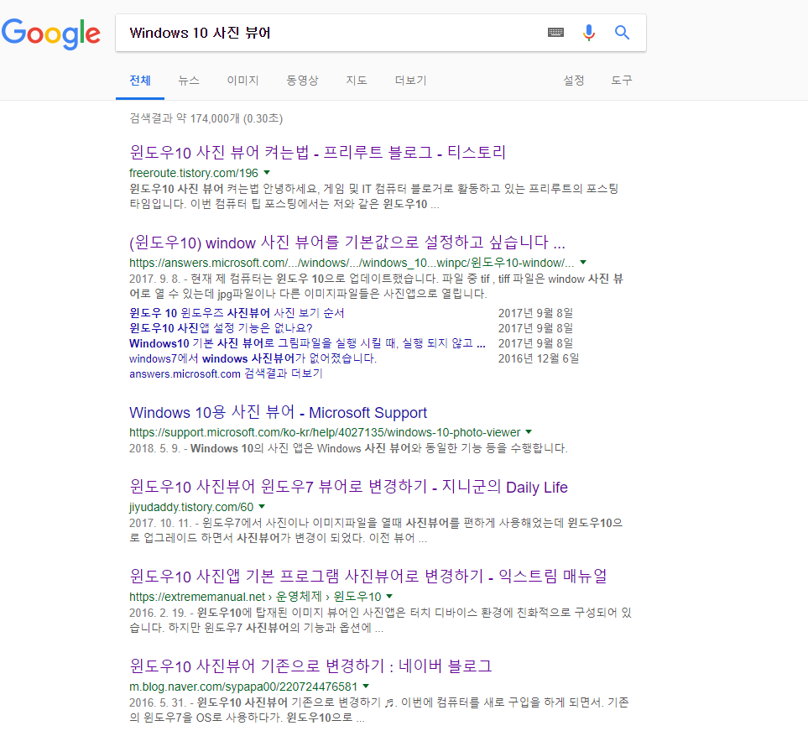
Introduce Image Viewer
Why?
Goal
Part

Slide 5
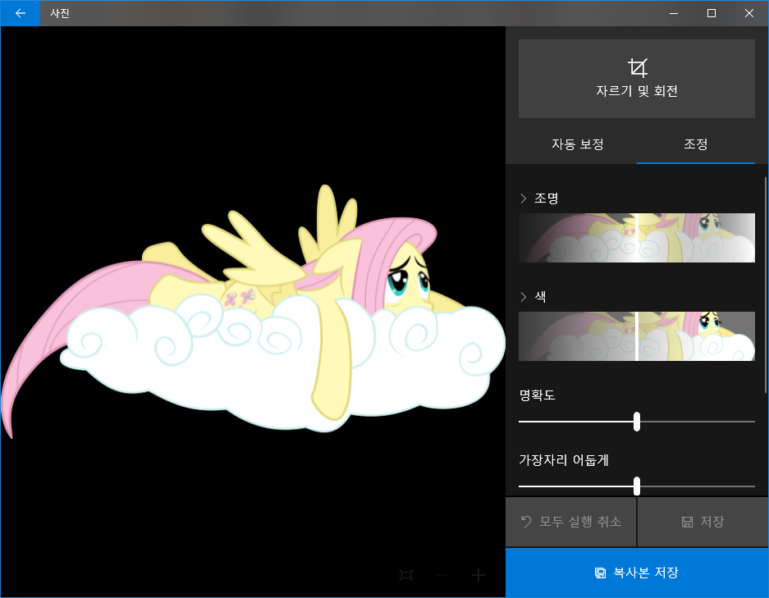
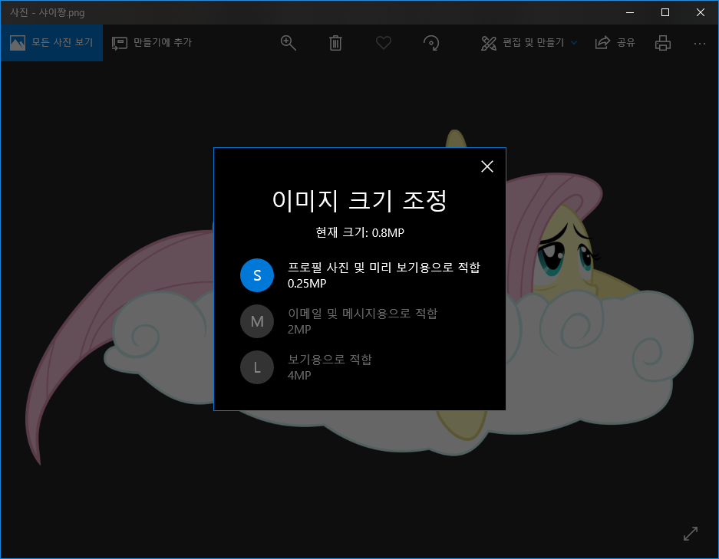
Introduce Image Viewer
Why?
Goal
Part

Slide 6
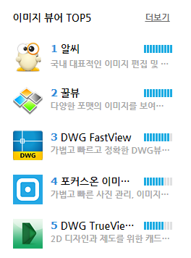
Introduce Image Viewer
Why?
Goal
Part

Slide 7
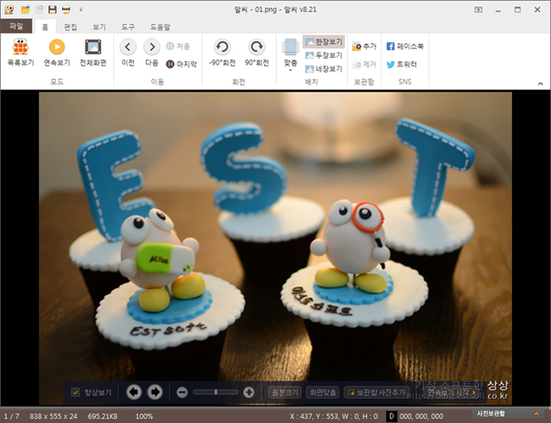
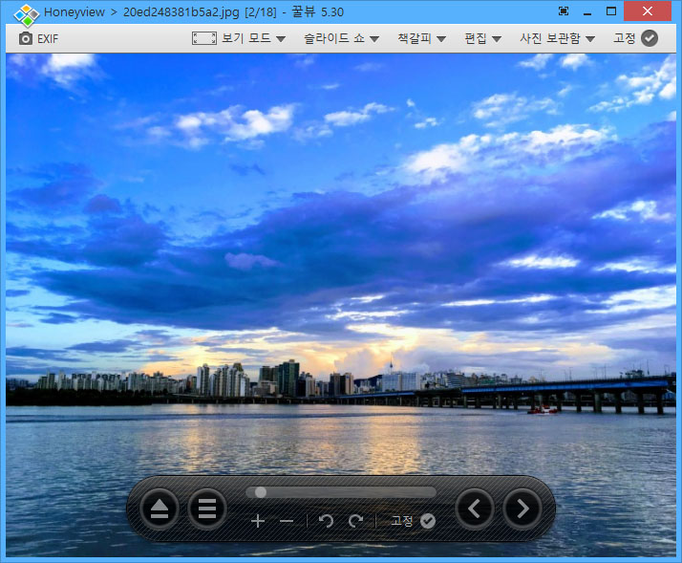
Introduce Image Viewer
Why?
Goal
Part

Slide 8
Introduce Image Viewer
UserInterface
Why?
Speed
Goal
Technology
Part

Slide 9
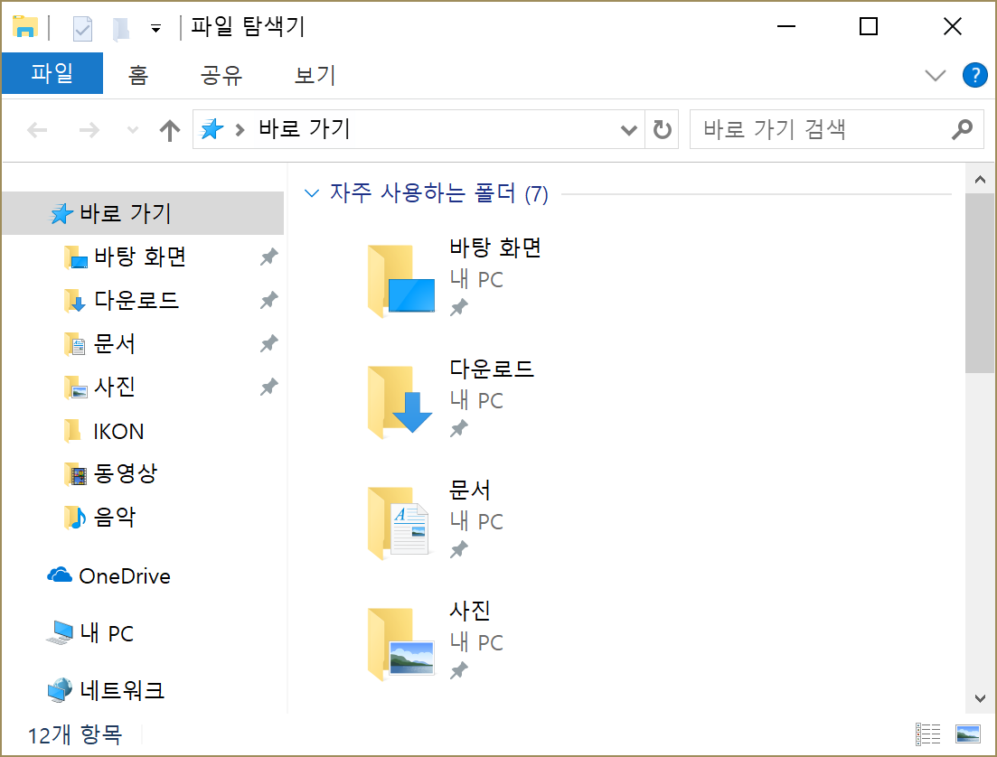
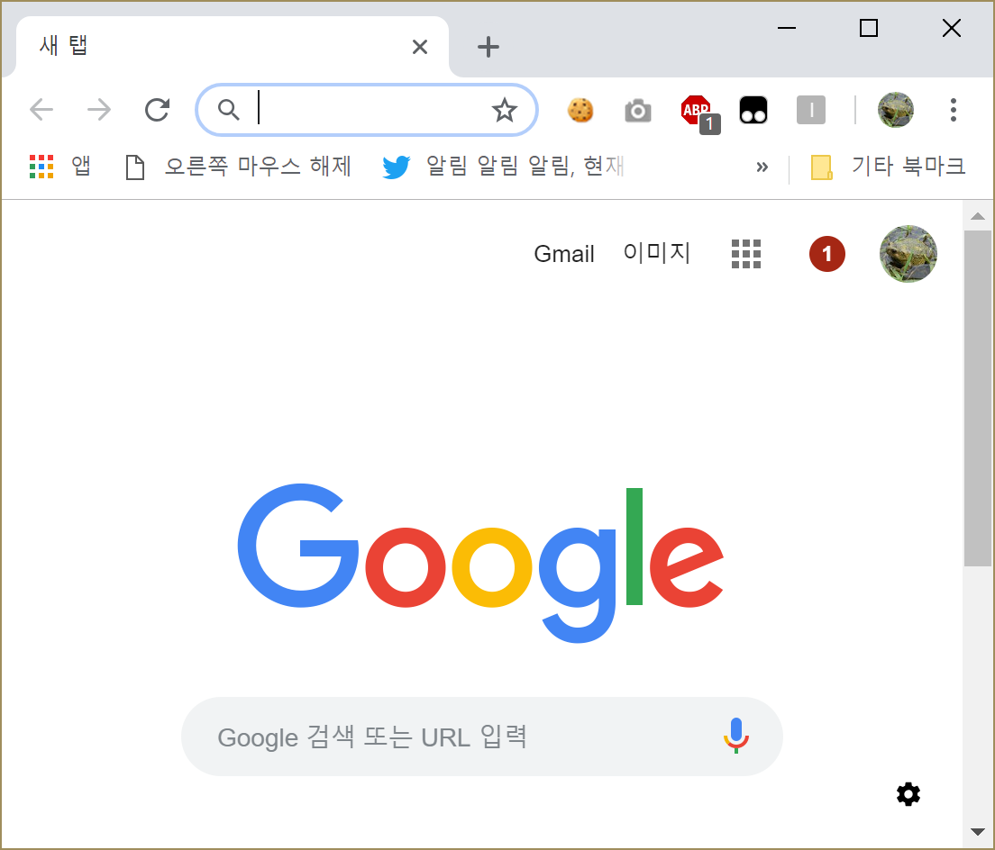
Introduce Image Viewer
UserInterface
Why?
Speed
Goal
Technology
Part

Slide 10
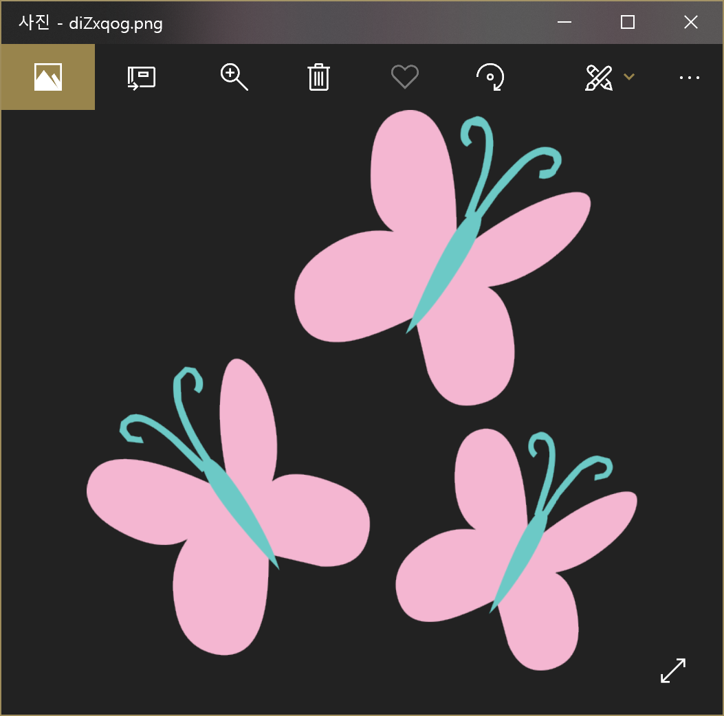

Introduce Image Viewer
Image Viewer
UserInterface
Why?
Speed
Goal
Technology
Part

Slide 11
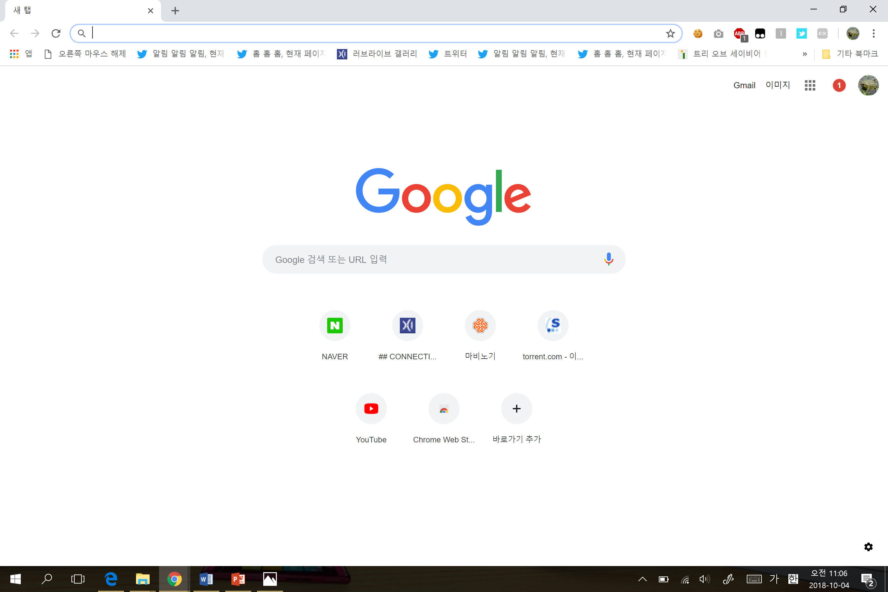

Introduce Image Viewer
UserInterface
Why?
Speed
Goal
Technology
Part

Slide 12
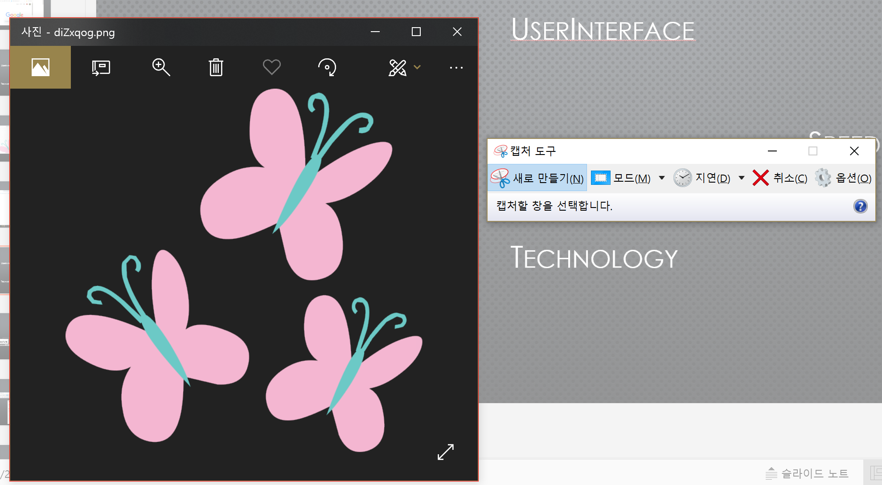
Introduce Image Viewer
UserInterface
Why?
Speed
Goal
Technology
Part

Slide 13
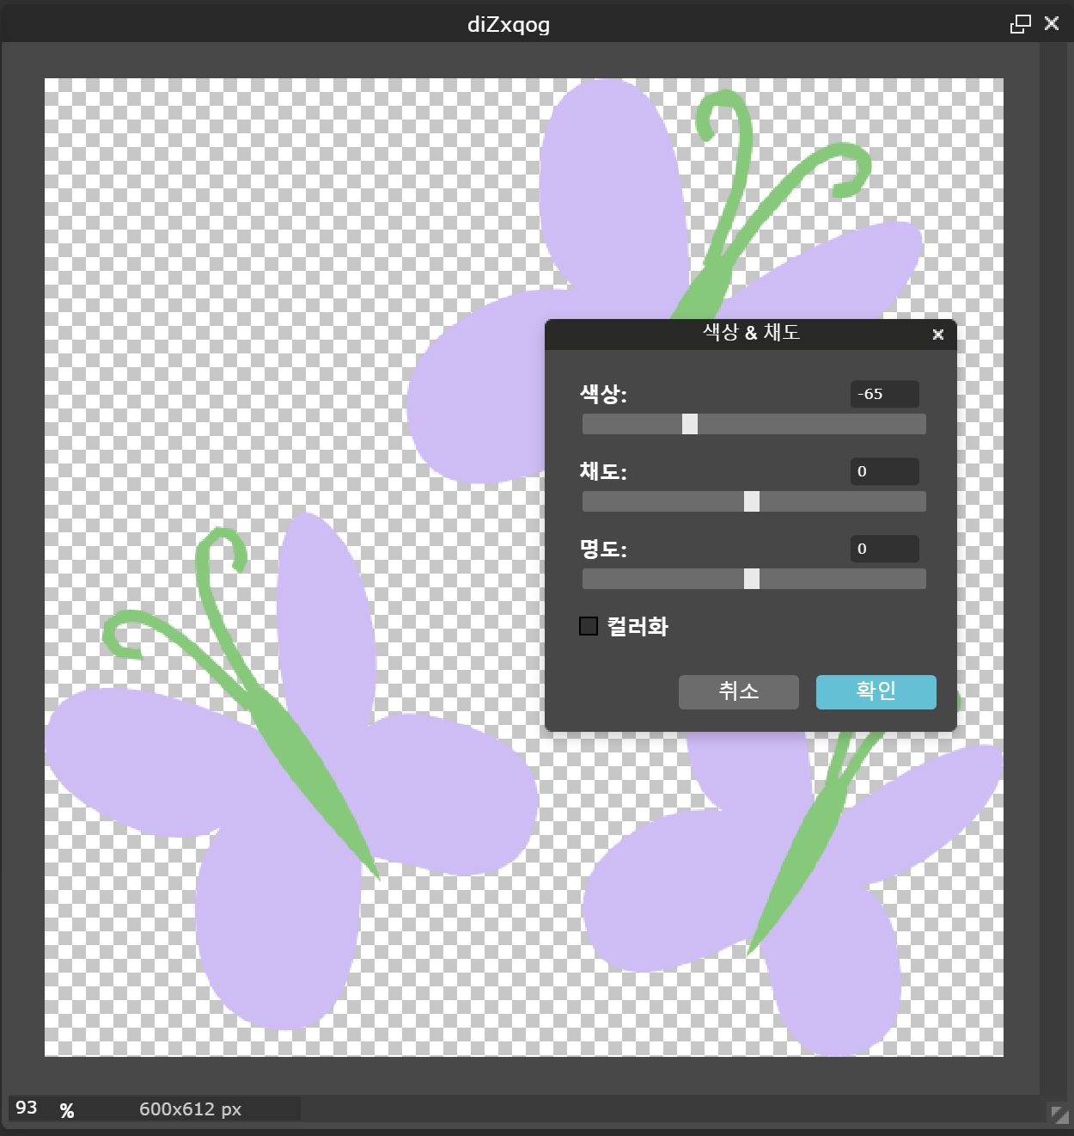
Introduce Image Viewer
UserInterface
Why?
Speed
Goal
Technology
Part

Slide 14
Introduce Image Viewer
Image Viewer
Chief - 김신유
Capture
Director - 이산아
Viewer
Director- 김신유
Modify
Director - 배진오
Why?
Goal
Part

Slide 15
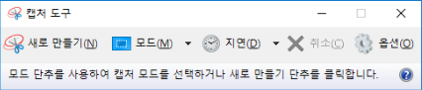
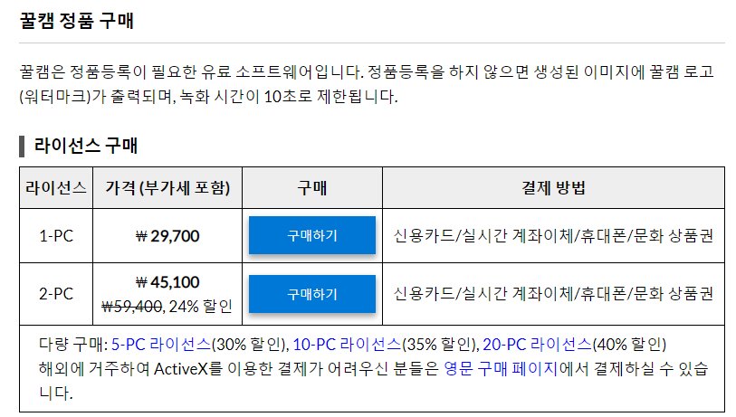
Introduce Image Viewer
Why?
Goal
Part

Slide 16
progress
IDE – Qt
LANGUAGY – C++
뷰어의 속도를 위해 각각의 프로그램은 필요시에 따로 로딩

Slide 17
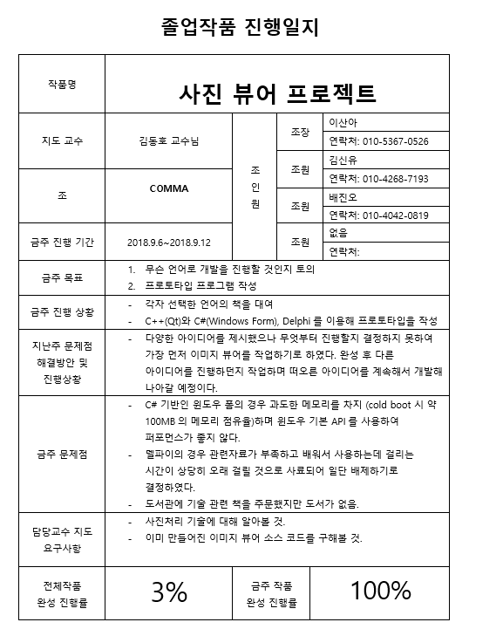
1주차 진행일지

Slide 18
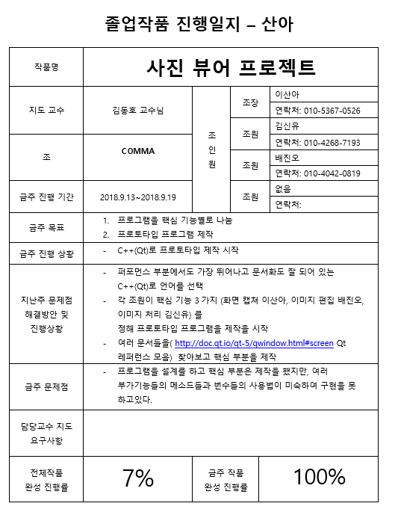
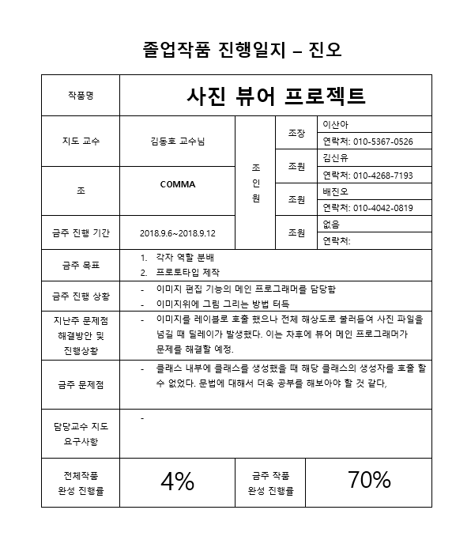
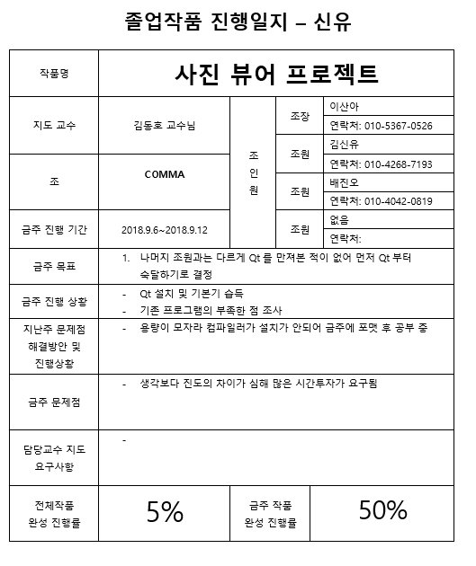
2주차 진행일지

Slide 19
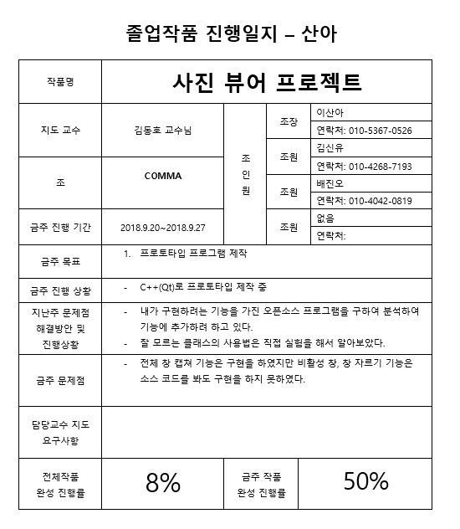
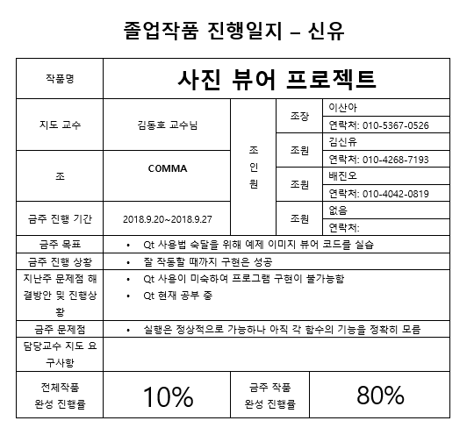
3주차 진행일지

Slide 20
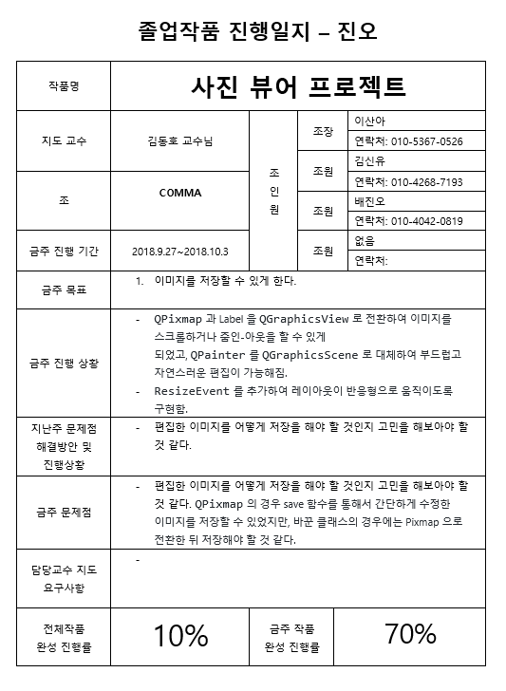
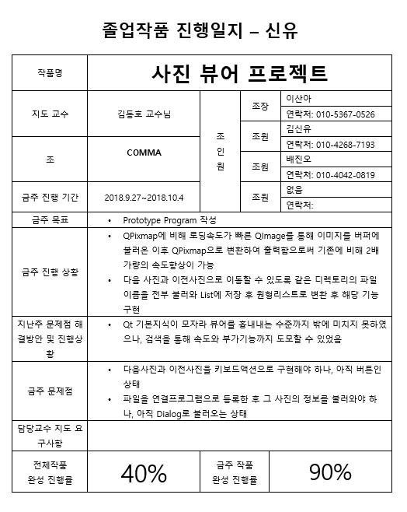
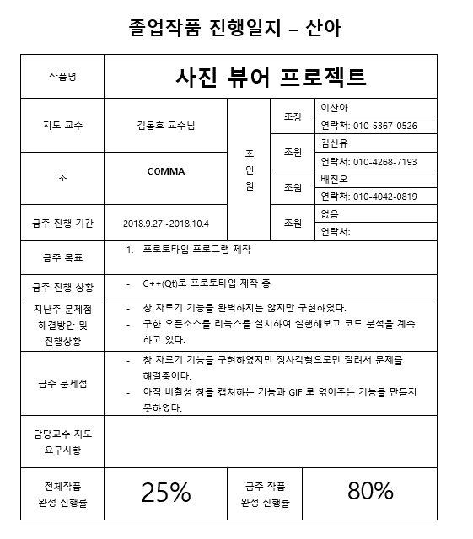
4주차 진행일지

Slide 21
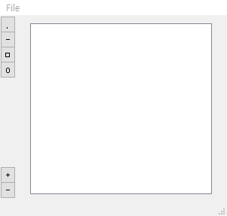
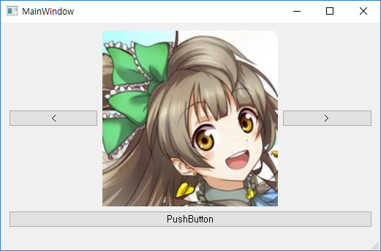
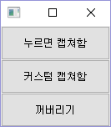
진행현황
Viewer
Capture
Editor

Slide 22

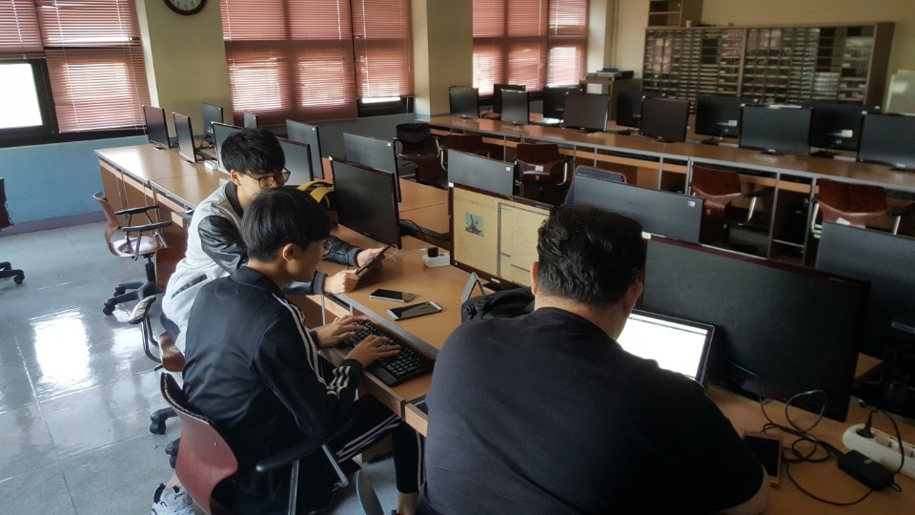
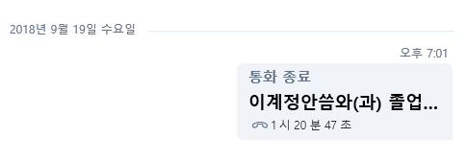
1차 미팅
2018. 9. 18 오프라인 미팅
2018. 9. 19 온라인 미팅

Slide 23
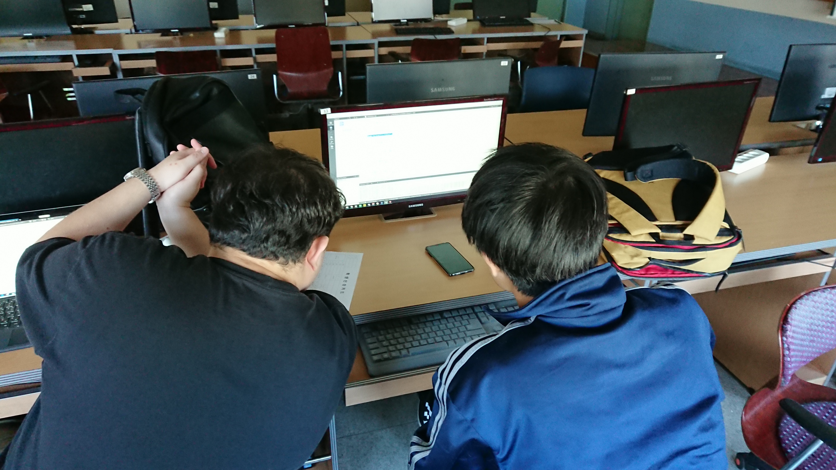
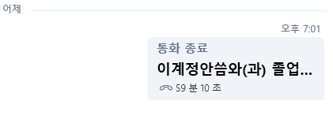
2차 미팅
2018. 10. 02 오프라인 미팅
2018. 10. 03 온라인 미팅

Slide 24
Thank You

